Slide 1
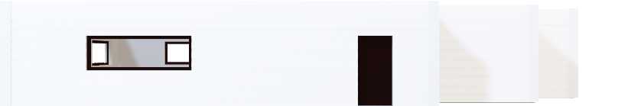
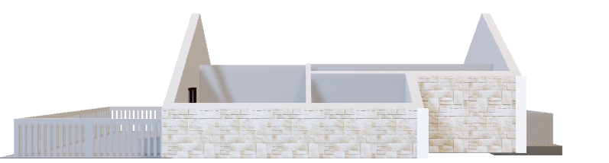
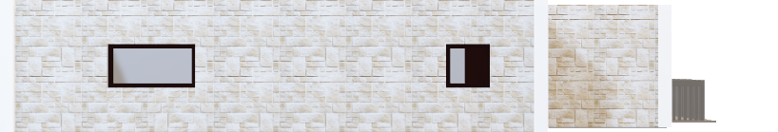
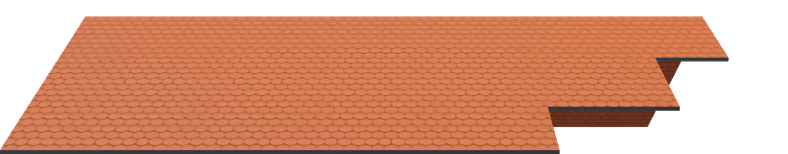
Ames Project Phase 1 Deliverable 1
Elizabeth Taylor
BAN 502 Predictive Analytics

Slide 2
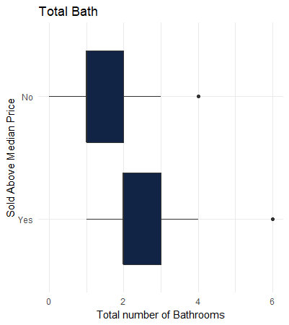
There are many things that go into the sale price of a house and if it sells over the average sale price. This presentation will look at a few of the factors that make homes sell for above the average.
Total Number of Bathrooms
Here we can see that homes with more bathrooms usually sold for above the median sale price.
* This data was created by combining Full Bath with Half Bath

Slide 3
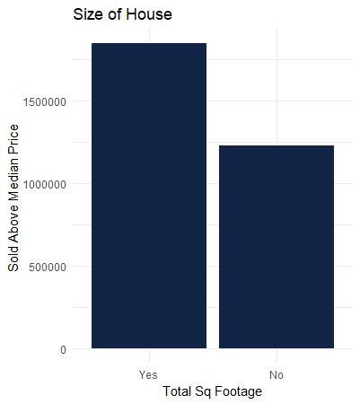
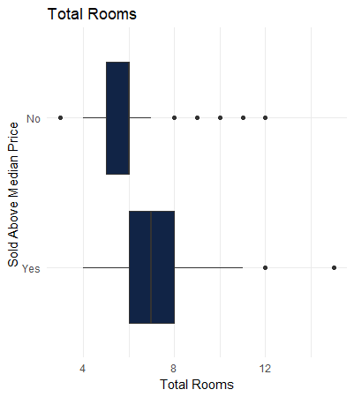
Total Rooms and Square Feet in house influence if a house sells above the median price.

Slide 4
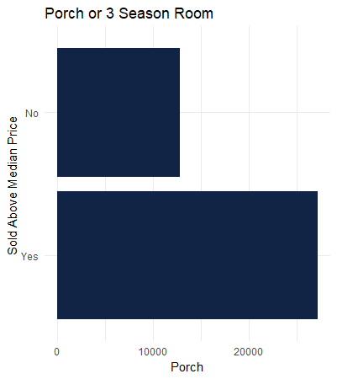
Some rooms are considered a perk and not necessary but nice to have. A porch or a 3-season room is one of those rooms.
Porch or 3 Season Room
Houses with a porch or three season room appear to sell for above the median sale price according to the data.
*This data was created by combing Three season room with Screen Porch

Slide 5
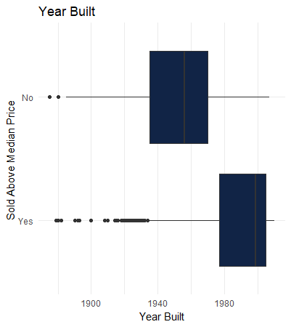
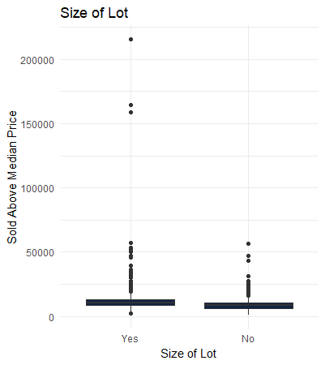
The year the house was build had an impact on the sale price. Generally new homes sold for above the median. The size of the lot did not have a big impact on home selling for more than the average.

